Slide 1
Python for Chemists and Biochemists
Find a seat where you can see the screen and get your laptop out
Take a sticky note of each color (pink, green, blue)

Slide 2
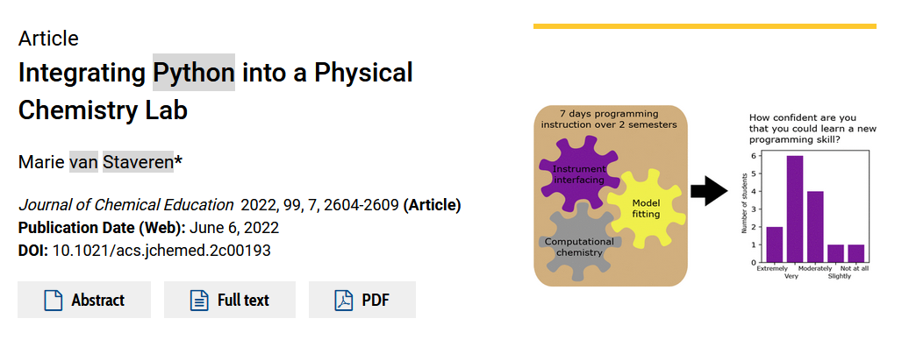

How’d we get here
Grad work: modeling four wave mixing experiments using Python
Connected to the astronomy Python community, Software Carpentry
Attended MolSSI Train the Trainers workshop at BCCE this summer
Thought maybe the grads should catch up to our undergrads…

Slide 3
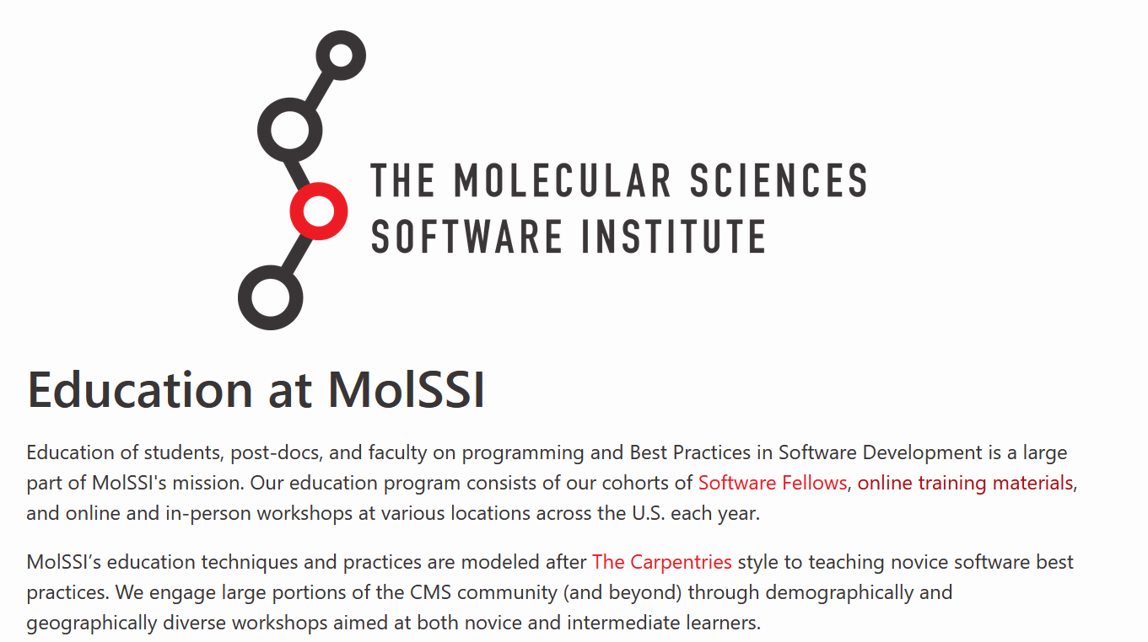
MolSSI

Slide 4
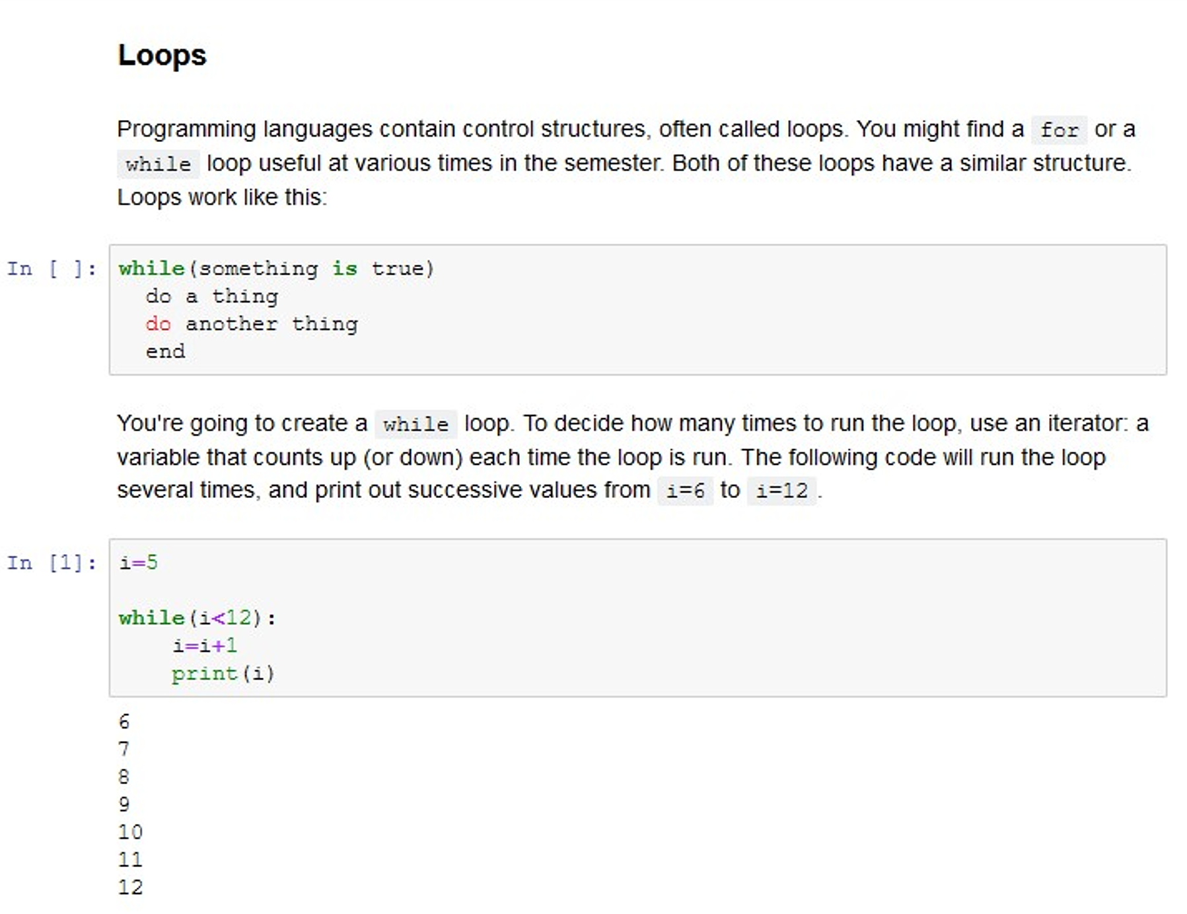
The language
Python
Open source
The standard in many areas of science and engineering
Robust stack of libraries to solve almost any scientific problem
Good Monty Python Jokes
Jupyter
Like a lab notebook
Less intimidating for scientists
The method for analyzing data from JWST

